Slide 1
Algorithm Design

Slide 2
What is an algorithm?
Algorithm: method for solving a problem.
Data structure: method to store information.

Slide 3
Why study an Algorithm?
Broad and far-reaching impact in the real world
Internet: Web search, packet routing, distributed file sharing, ...
Biology: Human genome project, protein folding, …
Computers: Circuit layout, file system, compilers, …
Computer graphics: Movies, video games, virtual reality, …
Security: Cell phones, e-commerce, voting machines, …
Multimedia: MP3, JPG, DivX, HDTV, face recognition, …
Social networks: Recommendations, news feeds, advertisements, …
Physics: N-body simulation, particle collision simulation, …

Slide 4
Why study an Algorithm?
For Intellectual Stimulation
“ For me, great algorithms are the poetry of computation. Just like verse, they can be terse, allusive, dense, and even mysterious. But once unlocked, they cast a brilliant new light on some aspect of computing. ” — Francis Sullivan
“ An algorithm must be seen to be believed. ” — Donald Knuth

Slide 5
Why study an Algorithm?
For Intellectual Stimulation
“ For me, great algorithms are the poetry of computation. Just like verse, they can be terse, allusive, dense, and even mysterious. But once unlocked, they cast a brilliant new light on some aspect of computing. ” — Francis Sullivan
“ An algorithm must be seen to be believed. ” — Donald Knuth

Slide 6
Why study an Algorithm?
To become a proficient programmer.
“ I will, in fact, claim that the difference between a bad programmer and a good one is whether he considers his code or his data structures more important. Bad programmers worry about the code. Good programmers worry about data structures and their relationships. ” — Linus Torvalds (creator of Linux)
“ Algorithms + Data Structures = Programs. ” — Niklaus Wirth

Slide 7
Characteristics of a good algorithm
An algorithm is any well-defined computational procedure that
takes some value, or set of values, as input and
produces some value, or set of values, as output.
An algorithm is thus a sequence of computational steps that transform the input into the output.
Predict performance in terms of time and space complexities. – Number of steps, recursion and processing should be optimized.

Slide 8
Learning Objectives
Understand Problems & Build algorithms
Analyse algorithm for following design requirements
Functional
Performance
Reliability
Modularity
Extensibility
Parallelism
Portability

Slide 9
Component Design
Software Component
Input Validation
Output Formatting
Interface 1
Core Algorithm
Interface 1
Interface 2
Interface 2
Interface 3
Data Storage
Interface 3

Slide 10
Component design – key aspects to consider
What is the basic problem that this component is addressing?
What are the inputs needed and their characteristics?
Configurable parameters – data types, i/o interfaces, non-functional requirements
Data that would be used for computing
Interfaces – keyed in inputs, files, shared memory, message pipes, queues etc
What are the input validations required? Remember – Garbage In-Garbage Out
How is the input data and output data stored? – data structures
What are the expected outputs and their characteristics?
What are the non-functional requirements? Performance – load handling, latency, portability, security, reliability etc.

Slide 11
Module Design
Input Interface
Software Component
Software Component
Output Interface
Interface 1
Input Validation
Core Algorithm
Output Formatting
Interface 1
Interface 1
Input Validation
Core Algorithm
Output Formatting
Interface 1
Interface 2
Interface 2
Interface 2
Interface 2
Interface 3
Data Storage
Interface 3
Interface 3
Data Storage
Interface 3
Software Component
Interface 1
Input Validation
Core Algorithm
Output Formatting
Interface 1
Interface 2
Interface 2
Input buffers
Interface 3
Data Storage
Interface 3
Output buffers
Platform Interface

Slide 12
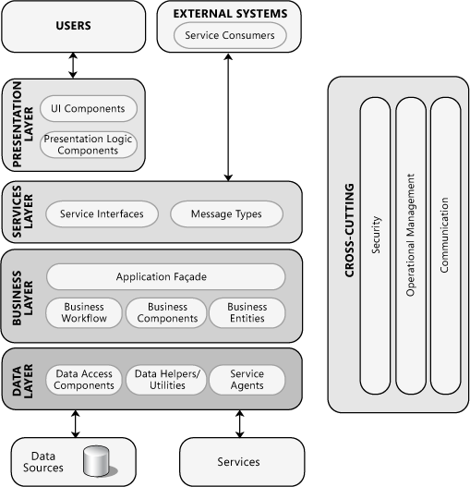
System Design – Layered Architecture
Source: https://msdn.microsoft.com/en-us/library/ee658124.aspx

Slide 13
Module/Design Steps
Decompose system/module into components and interfaces
i.e., identify the software architecture
Determine relationships between components
e.g., identify component dependencies and determine inter-component communication mechanisms
Specify component interfaces
Interfaces should be well-defined - Facilitates component testing and team communication
Describe component functionality - informally or formally
Identify opportunities for systematic reuse - Both top-down and bottom-up

Slide 14
Typical Architecture Patterns
Category | Architectural Design | Description
Communication | Message bus | Prescribes use of a software system that can receive and send messages using one or more communication channels.
 | Service–Oriented Architecture (SOA) | Defines the applications that expose and consume functionality as a service using contracts and messages.
Deployment | Client/server | Separate the system into two applications, where the client makes requests to the server.
 | 3-tier or N-tier | Separates the functionality into separate segments with each segment being a tier located on a physically separate computer.
Domain | Domain Driven Design | Focused on modeling a business domain and defining business objects based on entities within the business domain.
Structure | Component Based | Breakdown the application design into reusable functional or logical components that expose well-defined communication interfaces.
 | Layered | Divide the concerns of the application into stacked groups (layers).
 | Object oriented | Based on the division of responsibilities of an application or system into objects, each containing the data and the behavior relevant to the object.

Slide 15
Let us start with taking up some challenges Learning by doing

